Slide 1
FRIPSY Foothills Reforestation Interactive Planning System
Linking silviculture to growth and yield
Part 3.
Exploring Treatment Effects
Notes:
Welcome again to FRIPSY.
In this last part of our tutorial, we will explore and demonstrate predicted effects of reforestation treatments on stand development and, hopefully, in so doing, will give you some ideas on how you might use FRIPSY to do this for yourself.

Slide 2
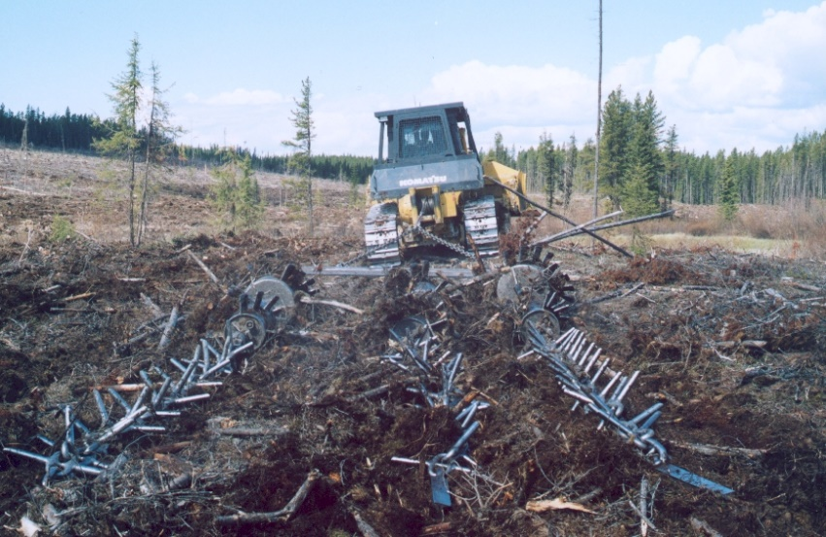
Drag scarification
Notes:
Let’s start with mechanical site preparation – the effects of drag scarification and mounding.
Here you see the input screen set up to explore the effects of drag scarification.
The stand , site and establishment factors selected here are based on average or modal conditions observed in the FGrOW Regenerated Lodgepole Pine trial. They are typical of what you might expect in the Upper Foothills of west-central Alberta, close to the transition into the Lower Foothills.

Slide 3
Drag scarification
Notes:
Under events, we have selected “drag” in the site preparation box, and indicated that it takes place in the same timber year that the stand is harvested. We have selected no other treatments.

Slide 4
No site preparation
Drag scarification
Notes:
When we compare the resulting regeneration forecast with that assuming no site preparation, we see that the number of trees per ha of lodgepole pine, all naturally regenerated without planting, is much increased by scarification.

Slide 5
No site preparation
Drag scarification
Notes:
This is projected to increase the coniferous mean annual increment and merchantable volume yield of the stand.

Slide 6
No site preparation
Drag scarification
Notes:
But notice also that the age of merchantable MAI culmination has increased with site preparation. We believe this is because of the diameter growth of individual trees being slowed by increased inter-tree competition resulting from the higher stand density.

Slide 7
No site preparation
Drag scarification
Notes:
Here are the yield tables generated in the GYPSY reports of the two runs.
The arrows point to where MAI culminates- a bit later for the treated stand than for the untreated one.

Slide 8
No site preparation
Drag scarification
Notes:
However, note that at 80 years stand age, volume yield and MAI are already higher with drag scarification than without, even though MAI has not quite culminated.

Slide 9
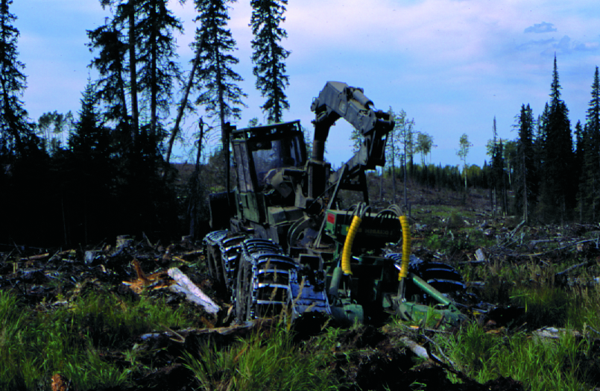
Mounding
Notes:
Our research shows little effect of mounding on the amount of natural regeneration, but mechanical site preparation – both scarification and mounding - improves the health and survival of planted lodgepole pine.

Slide 10
Mounding
Notes:
In this example, we show inputs for a stand planted following site preparation by mounding. The site is typical of the Upper Foothills in most respects, except that the seed supply from ground cones is poor,.

Slide 11
Mounding
Notes:
Since we want to demonstrate treatment effects on planted stock, we will exclude pine ingress from the simulation. We will also use this example to demonstrate the western gall rust adjustment feature, whereby we discount the number of trees included in the yield projection by the proportion expected to have main-stem infection at the handover age.

Slide 12
No site preparation
Mounding
Notes:
The resulting regeneration forecasts indicate that, by the time we do a performance assessment, survival of the 2000 trees per ha that were planted, will be better following mounding, than after no site preparation.

Slide 13
No site preparation
Mounding
Notes:
And by the end of the regeneration phase, the number of healthy living trees reaching breast-height is more with, than without, mounding.

Slide 14
No site preparation
Mounding
Notes:
This translates into an increase in projected MAI by mounding.
(Top height is less with mounding because age is 1 year younger).

Slide 15
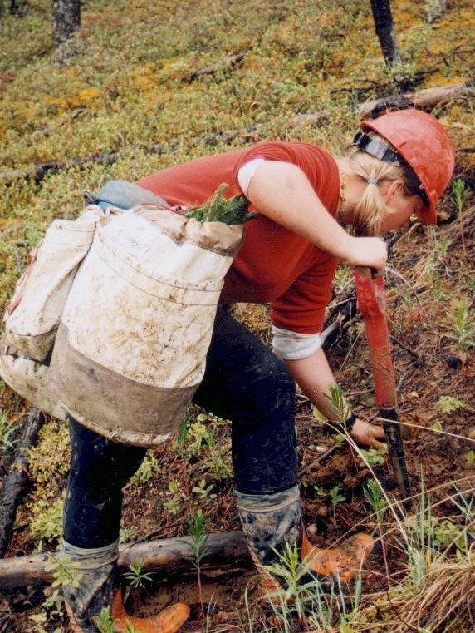
Planting
Notes:
Planting is widely undertaken in Alberta’s foothill forests to assure prompt regeneration of lodgepole pine.
It is particularly important where sparse natural regeneration is expected, such as under the site conditions described in this example.

Slide 16
Planting
Notes:
Here we will look at the effectiveness of planting a fairly low number of trees per ha (i.e. just over 1100 trees on a square 3m spacing after site preparation by mounding.

Slide 17
No planting
Planting 1,111 tph (3 x 3 m)
Notes:
18 years after cut, with no planting, this stand is slowly regenerating to black spruce, with not much lodgepole pine present. Pine stocking and density are much improved by planting a year after cut.

Slide 18
No planting
Planting 1,111 tph (3 x 3 m)
Notes:
Without planting, the stand is not expected to culminate in MAI until age 125 years.
With planting, the MAI is expected to culminate at 80 years, with a much increased MAI and volume yield, predominantly of lodgepole pine.

Slide 19
No planting
Planting 1,111 tph (3 x 3 m)
Notes:
The trends in volume yields and MAI are further illustrated by these graphs extracted from the GYPSY report.

Slide 20
Planting
Notes:
Now let’s look at the effects of planting on a more typical Upper Foothills stand, which has better quality soil, and has been drag scarified.

Slide 21
No planting
Planting 1,111 tph (3 x 3 m)
Notes:
As might be expected, given the high stocking and density of pine natural regeneration that typically occurs under these conditions, we see little difference in the mean annual increment of the planted versus non-planted condition.

Slide 22
No planting
Planting 1,111 tph (3 x 3 m)
Notes:
And little difference between treatments is apparent when we look at the GYPSY curves for volume and MAI.

Slide 23
No planting
Planting 4,444 tph (1.5 x 1.5 m)
Notes:
Differences do become evident if we increase the planting density. We see here an increase in mean annual increment at a slightly reduced culmination age. But it has been achieved at the cost of a substantial increase in planting density.

Slide 24
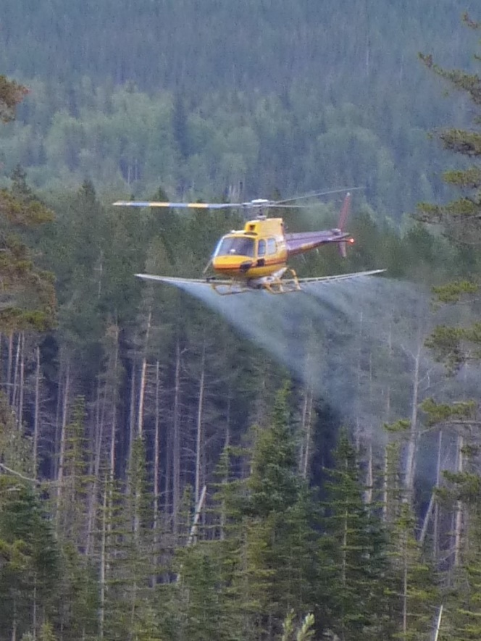
Weeding
Notes:
“Weeding” in FRIPSY refers to chemical vegetation management to control hardwood or herbaceous competition, by the application of glyphosate using standard best practices and application rates, within the 9 years following cut.
Hardwood competition, particularly from aspen, may be severe in the Lower Foothills, under the sort of site conditions identified in this example.

Slide 25
Weeding
Notes:
Let’s look at the effect of weeding on this site, after planting 2500 trees per ha.

Slide 26
No weeding
Weeding
Notes:
Without weeding, we see the majority of pine has died by the end of the regeneration phase.
Conversely, with weeding, much of the pine has survived and reached breast-height.

Slide 27
No weeding
Weeding
Notes:
Without weeding aspen densities are very high during the regeneration phase, though some self-thinning has occurred between performance assessment at 14 years, and handover at 18 years.
Weeding almost entirely eradicates the aspen component.

Slide 28
No weeding
Weeding
Notes:
Consequently, without weeding, even after waiting over 100 years for pine MAI to culminate, the stand is predominantly composed of aspen; while with weeding there is little aspen in the stand when the pine culminates at just over 70 years.

Slide 29
No weeding
Weeding
Notes:
The treatment has made all the difference from conifers being a very minor component of the stand, to a highly productive one.

Slide 30
No weeding
Weeding
Notes:
No weeding has resulted in the stand being regenerated to an almost pure hardwood condition, while weeding is projected to result in almost pure pine.
Current forest policy in Alberta requires stands that were predominantly coniferous when harvested to be reforested to a coniferous condition. However, note here that, in the absence of herbicide application, while the stand is unlikely to regenerate to conifer, the total long-term volume yield, combining both softwoods and hardwoods, is similar with or without treatment. Furthermore, MAI culminates earlier and higher with no weeding.

Slide 31
Weeding
Notes:
Let’s now simulate weeding a typical Upper Foothills stand, naturally regenerated after drag scarification.

Slide 32
No weeding
Weeding
Notes:
Here, both with and without weeding, lodgepole pine naturally regenerates at high densities.
The effect of herbicide is much less than in the previous example, as illustrated by the smaller difference in projected coniferous MAI between the treated and untreated condition.

Slide 33
No weeding
Weeding
Notes:
Although weeding does increase MAI, the effect is modest, with no significant reduction in culmination age.

Slide 34
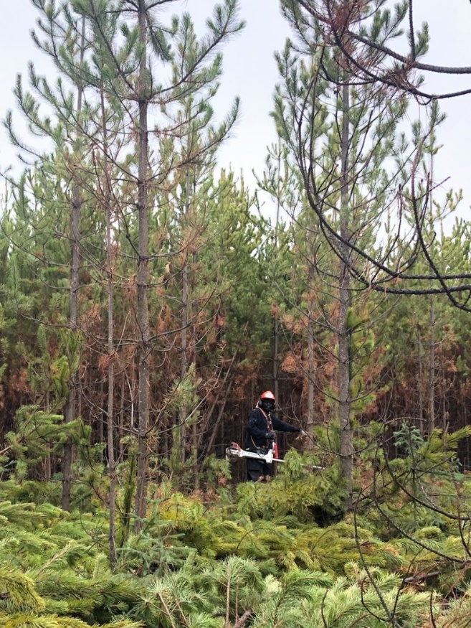
Thinning
Notes:
Now we will explore the effects of pre-commercial thinning, on a typical Upper Foothills stand, naturally regenerated after drag scarification. This is the same stand that we last looked at when investigating weeding effects.

Slide 35
Thinning
Notes:
Although herbicide application may be considered unnecessary on such a site, we will include it here, so that we can focus on the effects of thinning on lodgepole pine rather than on aspen, which we will come to later.

Slide 36
Thinning
Notes:
“Thin” in FRIPSY refers to low pre-commercial thinning undertaken before the end of the regeneration phase.
We will first investigate the effect of thinning to leave 4,444 trees per ha at handover, which equates to an average square spacing of 1.5 m. This is the highest post-thinning density that we targeted in the RLP trial.

Slide 37
No thinning
Thinning to 4,444 tph (1.5 x 1.5 m)
Notes:
Note here that 13 years after cut we have thinned the stand from over 20,000 trees per ha 30cm+ in height, to 6,878, which is expected to result in 4,444 trees per ha 1.3m+ at 18 years.

Slide 38
No thinning
Thinning to 4,444 tph (1.5 x 1.5 m)
Notes:
Without thinning, the pine density at handover would be over 12,000 trees per ha.

Slide 39
No thinning
Thinning to 4,444 tph (1.5 x 1.5 m)
Notes:
Thinning increases DBH at handover; but notice that at this stage of stand development the basal area of pine is still higher in the unthinned stand.

Slide 40
No thinning
Thinning to 4,444 tph (1.5 x 1.5 m)
Notes:
The yield projections indicate that thinning will increase merchantable MAI, and bring forward its culmination.

Slide 41
No thinning
Thinning to 4,444 tph (1.5 x 1.5 m)
Notes:
The GYPSY graphs of volume and increment over time illustrate how thinning is expected to accelerate the accumulation of merchantable volume, resulting in the increase in maximum MAI and its earlier culmination.

Slide 42
No thinning
Thinning to 4,444 tph (1.5 x 1.5 m)
Notes:
Here are the associated yield tables. The arrows point to where MAI culminates.

Slide 43
No thinning
Thinning to 2,500 tph (2 x 2 m)
Notes:
If we thin more heavily to 2,500 trees per ha, maximum MAI is reduced relative to the lighter thinning. As shown here, relative to the non-thinned condition, culmination is accelerated, but maximum MAI is only slightly higher.

Slide 44
No thinning
Thinning to 1,111 tph (3 x 3 m)
Notes:
If we thin right down to a 3m spacing, MAI is substantially reduced.

Slide 45
No thinning
Thinning to 1,111 tph (3 x 3 m)
Notes:
Note also that the merchantable volume yield at the 80 year culmination age, that we get with thinning, is less than in the non-thinned stand.

Slide 46
No thinning
Thinning to 4,444 tph (1.5 x 1.5 m)
Notes:
We have so far focused much attention on maximum MAI and when it culminates. This is because, under sustained yield timber management, MAI culmination age is often used for defining the rotation. Given current concerns in Alberta about MPB infestation, and the need to fill resulting shortfalls in timber supply, other criteria for harvest scheduling may become more relevant. In particular, we may need to know how soon trees can be expected to reach a sufficient size for utilization. In the example shown here, note how thinning is forecast to shorten the time taken to reach a particular average piece size.

Slide 47
Thinning
Notes:
The need for pre-commercial thinning will vary with site, stand and treatment factors, and particularly with the amount of pine natural regeneration.
Now that we have seen the effects of thinning on a typical Upper Foothills stand that was dragged and naturally regenerated, let us look at what might happen on a highly productive Lower Foothills site that has been mounded, planted, and weeded.

Slide 48
Thinning
Notes:
In this example, we planted 2000 trees per ha. If we target a post-thinning density of 4444 trees per ha, we get a message that this exceeds the available number of trees, resulting in the thinning being infeasible.

Slide 49
Thinning
Notes:
So we will instead investigate a post-thinning target of 2500 trees per ha.

Slide 50
No thinning
Thinning to 2,500 tph (2 x 2 m)
Notes:
The thinning is projected to only slightly increase MAI.

Slide 51
No thinning
Thinning to 2,500 tph (2 x 2 m)
Notes:
Here are the associated yield tables, with arrows indicating MAI culmination

Slide 52
No thinning
Thinning to 1,111 tph (3 x 3 m)
Notes:
If we thin more heavily to a 3 m spacing, , MAI is substantially reduced, though MAI culmination is brought forward about 10 years relative to the unthinned condition.

Slide 53
No thinning
Thinning to 1,111 tph (3 x 3 m)
Notes:
The heavier thinning also increases average piece size, relative to both the lighter thinning and no thinning treatments. The arrows here point to sizes at the shortened 60 year culmination age.

Slide 54
Thinning
Notes:
What would happen if, on a highly productive and competitive site, we relied on an manual thinning to remove aspen, rather than using herbicide?
In this scenario we have not weeded, but thinned at 11 years to a target pine density of 2000 trees per ha at handover.

Slide 55
No thinning
Thinning to 2,000 tph
Notes:
Thinning is projected to somewhat improve growth and yield, but to a much lesser extent than herbicide application would have.

Slide 56
No thinning
Thinning to 2,000 tph
Notes:
The weakness of the long-term treatment response may result from the vigorous re-suckering of aspen that follows thinning.

Slide 57
No thinning
Thinning to 2,000 tph
Notes:
As we can see from these GYPSY graphs , the removal of aspen during thinning is predicted to result in a mixedwood, rather than coniferous, stand type.

Slide 58
Summary and Conclusions
Effects of site preparation, planting, herbicide application and pre-commercial thinning
Influences of site and stand factors
Regeneration trends as observed in the RLP experimental trial and related research
Prudent and cautious application to forest management
Notes:
That concludes our tutorial.
We have used FRIPSY to explore some of the effects of reforestation treatments on regeneration and subsequent growth and yield.
We included examples of how these responses may be influenced by site and stand factors.
The trends demonstrated here and incorporated into FRIPSY are the result of over 20 years of research by the Foothills Pine Project Team of FGrOW.
As described in Part 1 of this tutorial, there are inevitably substantial remaining uncertainties about how post-harvest stands will develop over time.
Nevertheless, with prudent application and ongoing monitoring, we hope you will find FRIPSY useful in reforestation and timber supply planning,

Slide 59
Acknowledgements
ANC Timber
Canadian Forest Products
Millar Western Forest Products
Spray Lake Sawmills
West Fraser (Blue Ridge Lumber, Edson and Hinton Woodlands, Sundre Forest Products)
Weyerhaeuser (Grande Prairie and Pembina Timberlands)
FRIAA (Forest Resource Improvement Association of Alberta)
Alberta Agriculture, Forestry, and Rural Economic Development
Notes:
Thank you, and thanks to these organizations for their technical and financial assistance in developing FRIPSY

